Slide 1
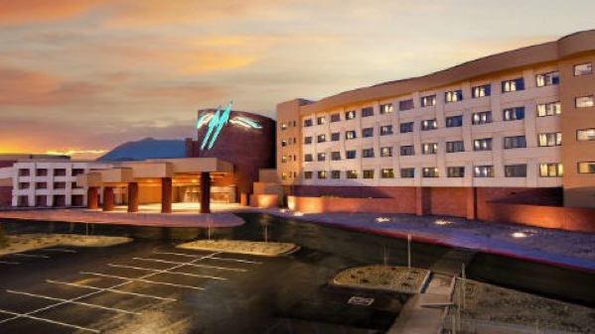
Navajo Employee Nutrition Project (Twin Arrows Casino)

Slide 2
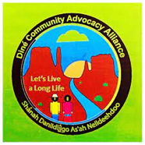
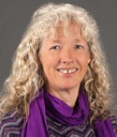
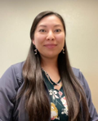
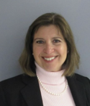
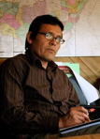
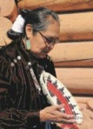
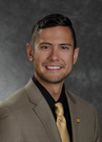
The Project Team & Partners
Jay Sutliffe, PhD, RD Alison Adams, PhD Kaitlyn Benally BS Julia Gardner, MPH Gigi Lopez, PhD Vicki Penna, MS, RDH Tony Skrelunas, MBA Caroline Trapp, DNP Grace Tracy Chad Webb, MS, RDH
NAU NAU Tribe Awaken NAU NAU NAU Tribe Awaken Consultant Consultant NAU

Slide 3
Previous Worksite Projects
NAU & NAH/Flagstaff Medical Center Employees
- Employee wellness focus; assessment; met weekly for lectures; cooking demos, food tasting
- Study Participants: 75% Caucasian; 9% Hispanic; 7% Native American; 86% Female; Average age 47 years old
- Program Results: 11.5% reduction in cholesterol; 17% in Bad Cholesterol (LDL); 18% improvement in quality of life; 24% improvement in sleep quality; 69% improvement in depressive symptoms; reduction in health care expenditures; student involvement
Ongoing Participant Support for Past Participants
- Monthly Meetup Education and Potlucks
What if we conducted a Navajo Specific Nutrition Intervention?
- July 2021: Awarded a National Institutes of Health (NIH) R15: 3-Year Grant
- One of the R15 grant goals is to expose students to research

Slide 4
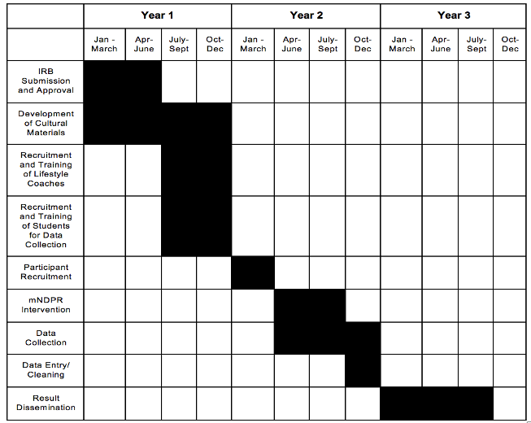
Timeline
Phase 1 – Develop culturally relevant nutrition materials based on existing intervention materials
Focus groups with diabetes educators and Twin Arrows employees.
Phase 2 – Train NAU MPH students/ community members to implement the intervention
Get input from stakeholders to develop the training
Evaluate the effectiveness of the training
Phase 3 – Implement the intervention
Phase 4 – Evaluate the effectiveness of the intervention
Phase 5 – Disseminate Results

Slide 5
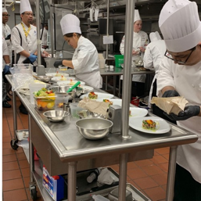
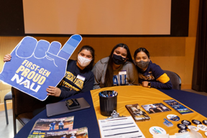
Phase 1: Curriculum Development
Focus groups with Twin Arrows Employees
Develop a Wellness Committee with Twin Arrows Employees
Develop and Test Navajo Recipes with Twin Arrows Chefs & Other Navajo Chefs
Phase 2: Student Coach Training & Evaluation
Recruit & Train NAU Navajo Students to lead weekly
intervention groups and support the project
Navajo Graduate Students Lead & Supervise the undergraduate students

Slide 6
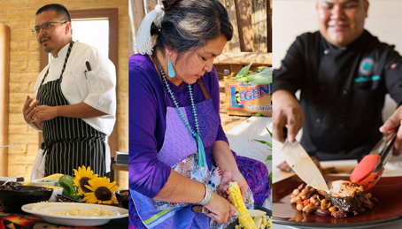
Phase 3: Intervention Implementation
12-week Nutrition intervention
146 participants total
Waitlist control – ALL participants will receive
the intervention regardless of group assignment
Incentive to participate
Approximately 12 sessions, 1-hour each
NAU MPH students will lead the group sessions
Weekly meetings held at Twin Arrows for participant convenience
Include oral health assessment and observation
Phase 4: Evaluate Intervention Effectiveness
Pre/post: assessment of medical risk factors; health care costs
Qualitative interviews to learn about participant’s experience and inform future project development

Slide 8
Phase 5: Dissemination of Results
Make all materials available for free use by any/all organizations
Publish manuscripts, include students!
Research conferences
Undergraduate Research Symposium (Undergraduate students present)
American Public Health Association
Presentation at Twin Arrows & Navajo Nation Gaming Enterprises, Inc
- Additional interventions at other Navajo Casinos
- Navajo Special Diabetes Project & Native Americans for Community Action – embed into existing programs
Presentation at Navajo IRB conference

Slide 9
